Slide 1
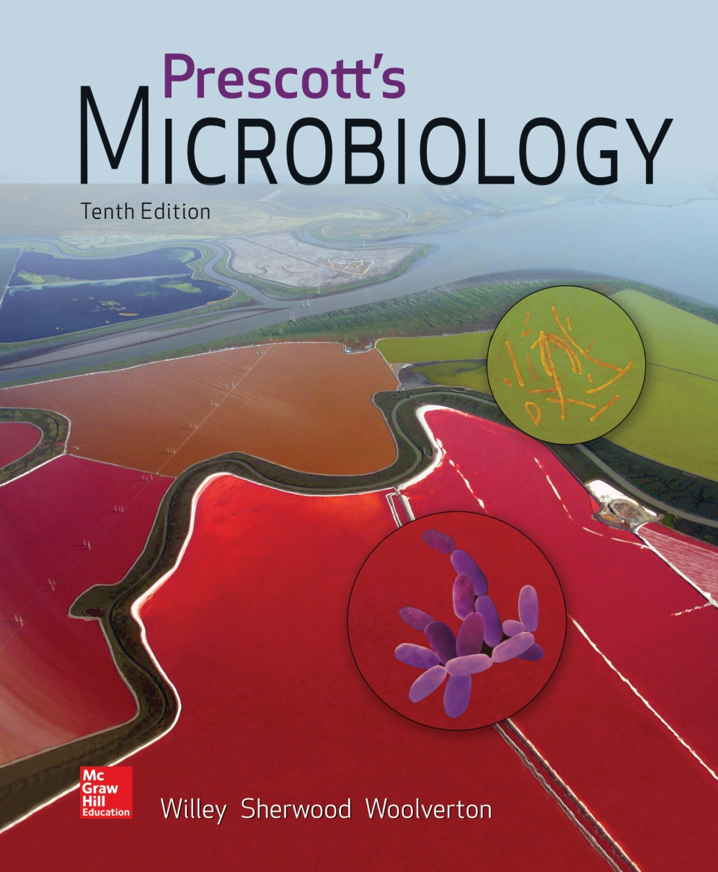
Chapter 23 – Firmicutes: The Low G+C Gram-Positive Bacteria

Slide 2
23.1 Class Clostridia
Identify several Clostridia spp. that form endospores
Outline the reaction by which some Clostridia can ferment amino acids, and relate this carbon substrate to their environmental distribution and pathogenic potential
Identify the terminal electron acceptors used by Desulfotomaculum spp.
Distinguish phototrophy in the heliobacteria from that of other anoxygenic phototrophic bacteria
Discuss the importance of Veillonella spp. to human disease

Slide 3
Gram-Positive Bacteria
Grouped based on shape (rods, cocci, or irregular) and ability to form endospores
Bergey’s Manual of Systematic Bacteriology, 2nd edition used phylogenetic relationships
Low G + C (Volume 3)
High G + C (Volume 4)

Slide 4
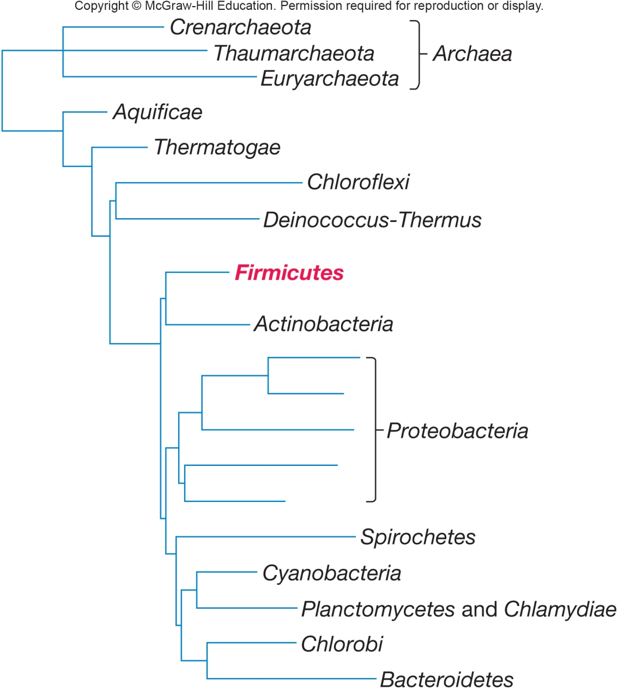
Low G + C Gram-Positive Bacteria Bergey’s Manual
Placed in phylum Firmicutes
divided into 3 classes
Clostridia
Bacilli
Negativicutes

Slide 5
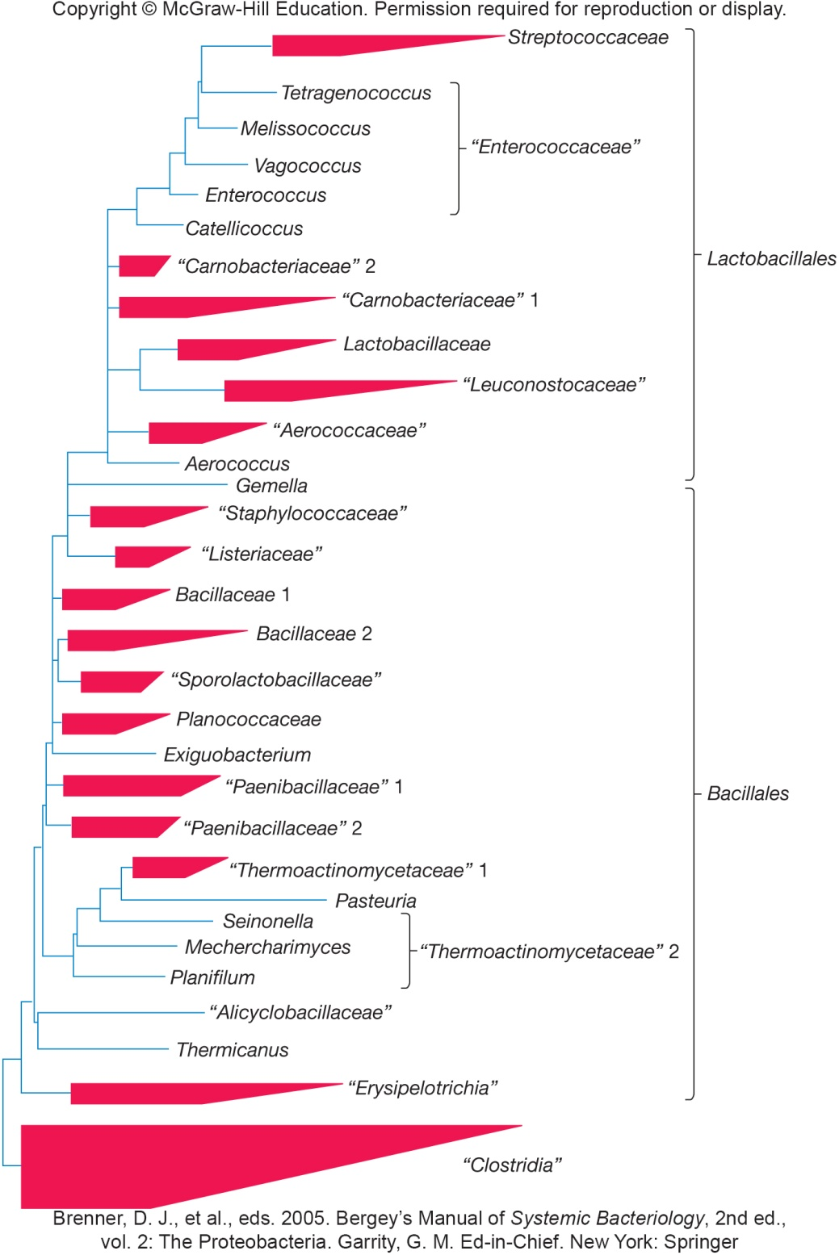
Phylogenetic Relationships in the Phylum Firmicutes

Slide 6
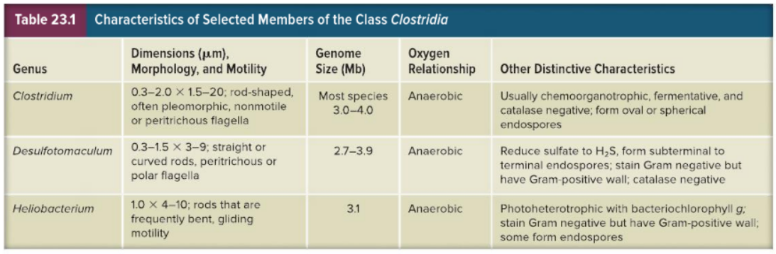
Class Clostridia
Largest genus is Clostridium
over 100 species
obligately anaerobic, fermentative, Gram-positive, endospore forming

Slide 7
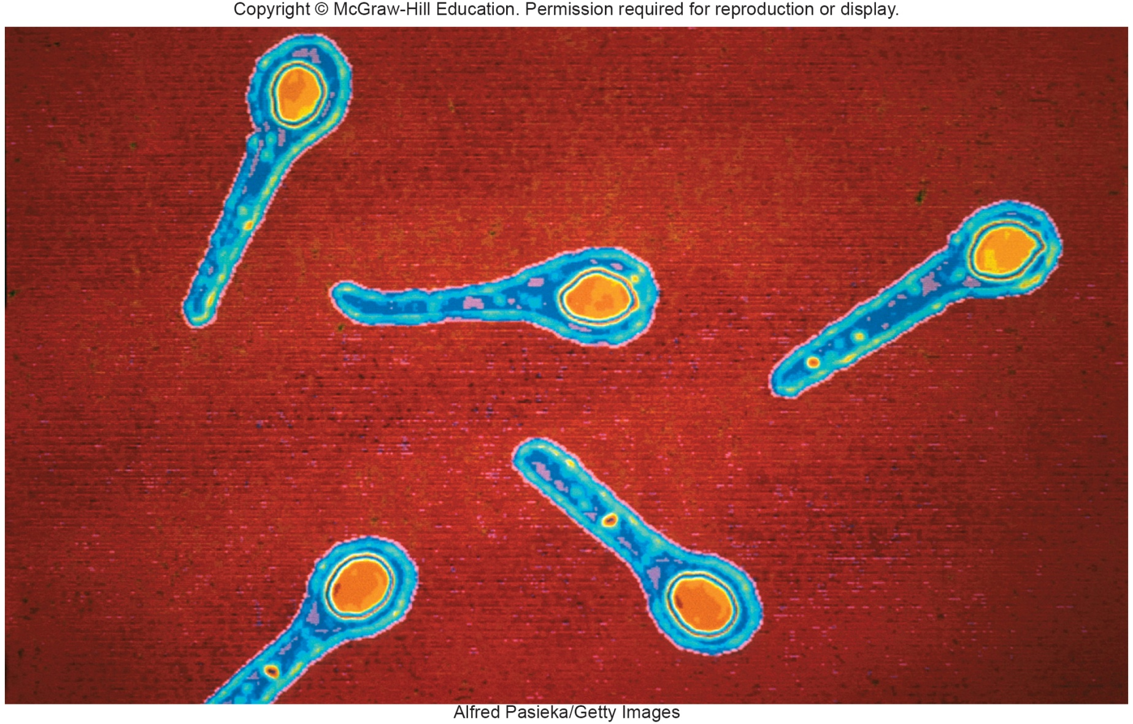
Clostridium tetani

Slide 8
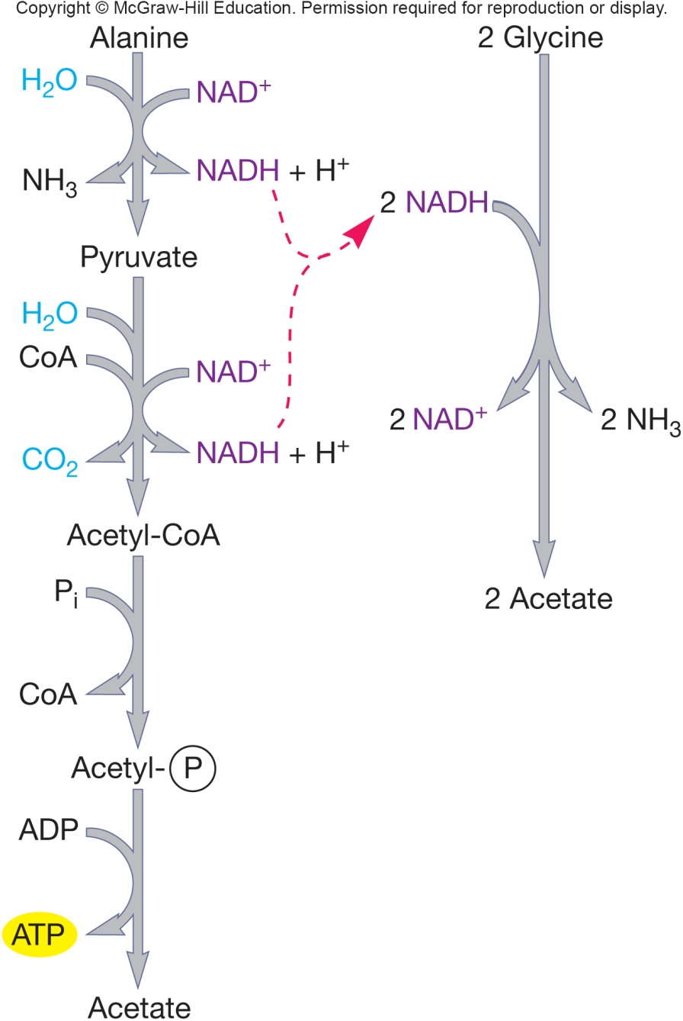
Genus Clostridium
Over 100 species in distinct phylogenetic clusters
Fermentative metabolism
ferment amino acids using Stickland reaction
oxidation of one amino acid using another as electron acceptor
sodium motive force to drive amino acid uptake
fermentation products responsible for unpleasant odors associated with putrefaction

Slide 9
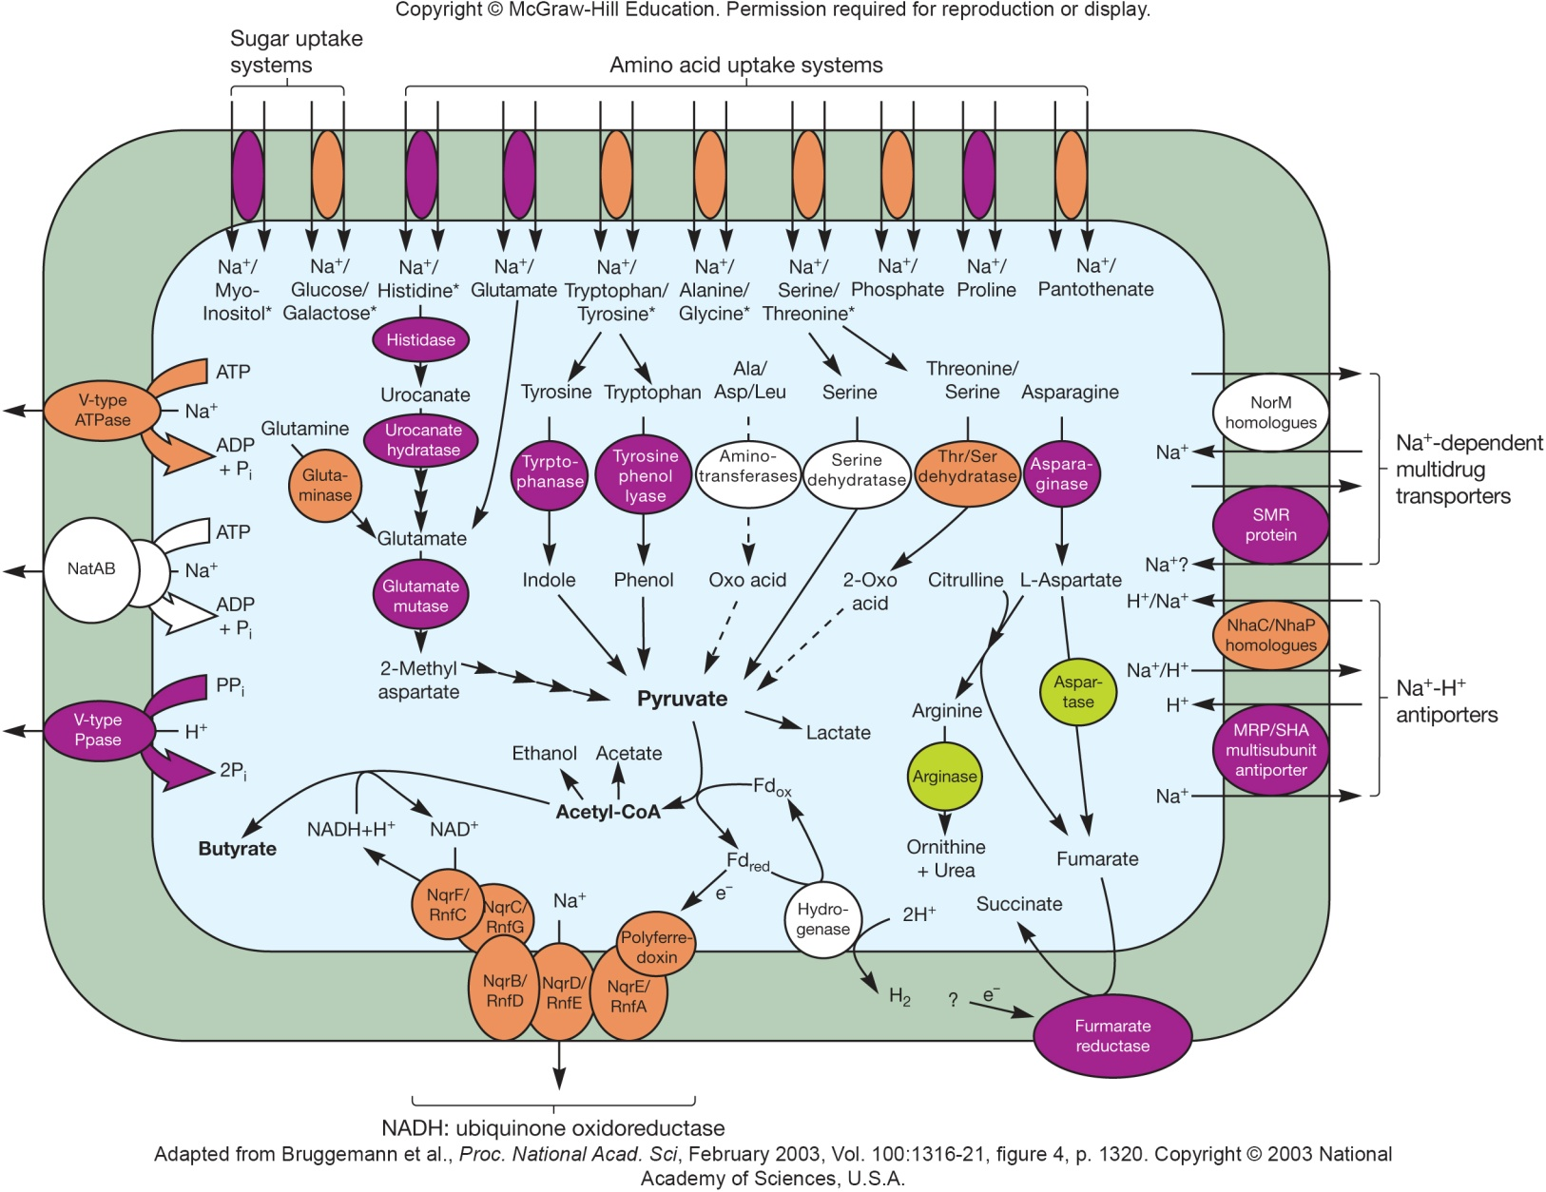
Amino Acid Fermentation and Na⁺ Flux in C. tetani

Slide 10
Important Species of Clostridium
Great practical importance
food spoilage through the Stickland reaction
industrial production of butanol
toxin production
C. botulinum
food spoilage (especially canned foods); botulism
C. tetani – tetanus
C. perfringens – gas gangrene
C. acetobutylicum
manufacture of butanol

Slide 11
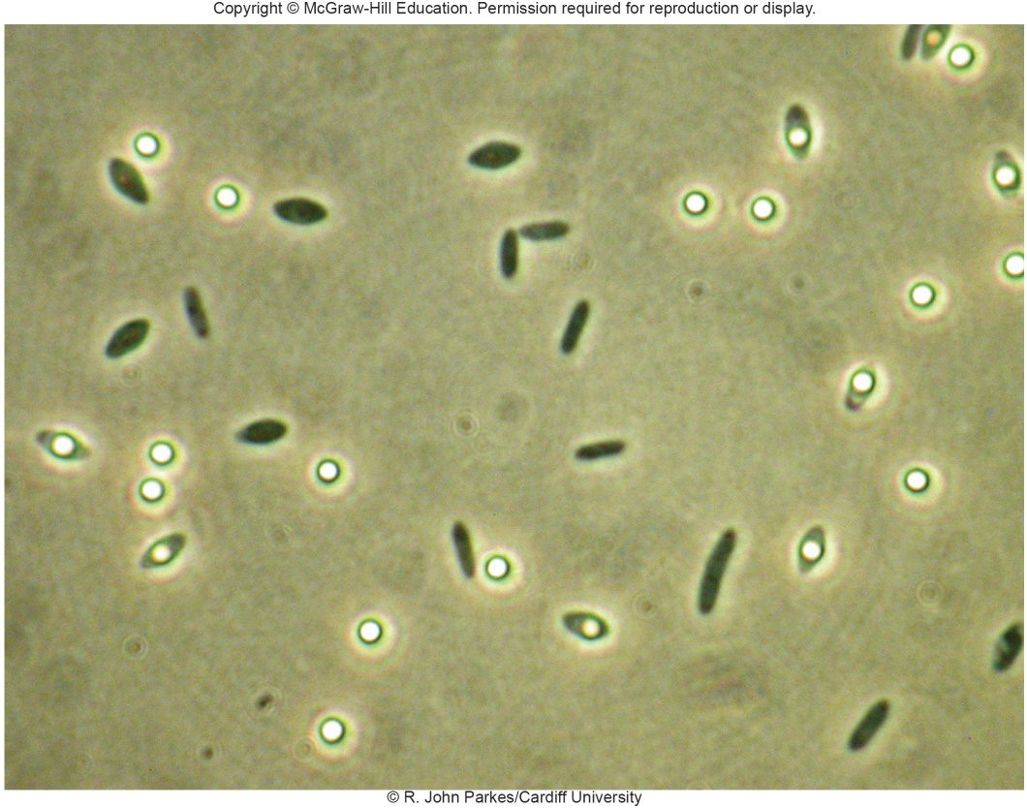
Genus Desulfotomaculum
Endospore forming
Reduces sulfate and sulfite to hydrogen sulfide during anaerobic respiration
Stains Gram-negative but in electron micrographs is seen to have a Gram-positive cell wall

Slide 12
Genera Heliobacterium and Heliophilum
Anaerobic, photosynthetic
bacteriochlorophyll g
have photosystem similar to green sulfur bacteria
pigments in plasma membrane
differ from anoxygenic photosynthetic bacteria in that they cannot grow autotropically

Slide 13
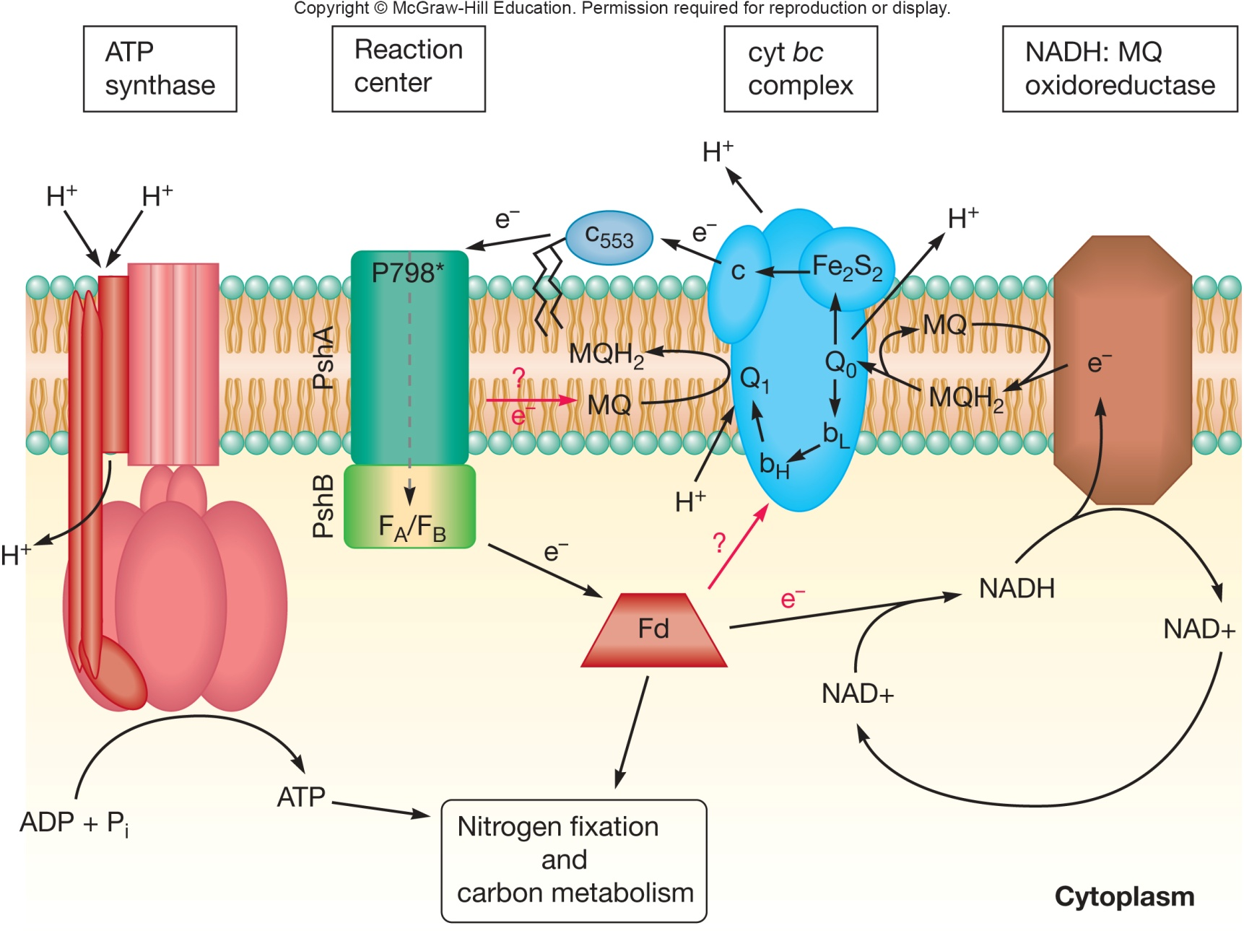
Electron Transfer in Heliobacterium

Slide 14
23.2 Class Negativicutes: Gram-Positive Bacteria with Outer Membranes
Explain why these bacteria are considered Gram-positive despite possessing outer membranes
Discuss why new taxonomic ranks must be developed
Identify the location where Veillonella spp. might be found on your body

Slide 15
Gram-Positive Microbes with an Outer Membrane
Negativicoccus succinicivorans was isolated from human skin and soft-tissue wounds in 2010
Possesses an outer membrane similar to Gram-negative microbes
16S rRNA sequences are more similar to Gram-positive microbes of Veillonellaceae family
This microbe belongs to the new class Negativicutes and order Selenomonadales
Two existing families, Acidaminococcaceae and Veillonellaceae, were then assigned to this new order

Slide 16
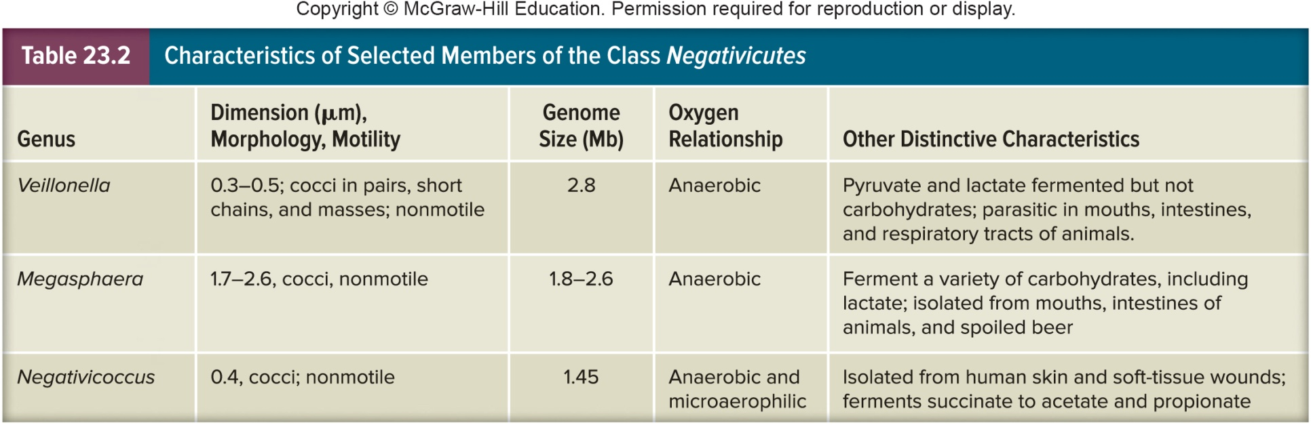
Genus Veillonella
Anaerobic, chemoheterotrophic
all have complex nutritional requirements
Normal biota of mouth, GI tract, urogenital tract of humans and animals
Found in infections of head, lung, female genital tract

Slide 17
23.3 Class Bacilli: Aerobic Endospore-Forming Bacteria
List terminal electron acceptors and fermentation products produced by Bacillus spp. and staphylococci
Discuss reasons that make Bacillus subtilis an important model organism
List three reasons why Bacillus spp. are of practical importance
Summarize the evolution and emergence of MRSA, and list at least two diseases caused by Staphylococcus aureus

Slide 18
23.3 Class Bacilli: Aerobic Endospore-Forming Bacteria, (continued)
Describe the structure and medical importance of Listeria monocytogenes
Identify the genera that are considered lactic acid bacteria, and discuss their importance in the food industry
Distinguish between enterococci and streptococci
Name bacterial genera capable of hemolysis, and differentiate between α-hemolysis and β-hemolysis

Slide 19
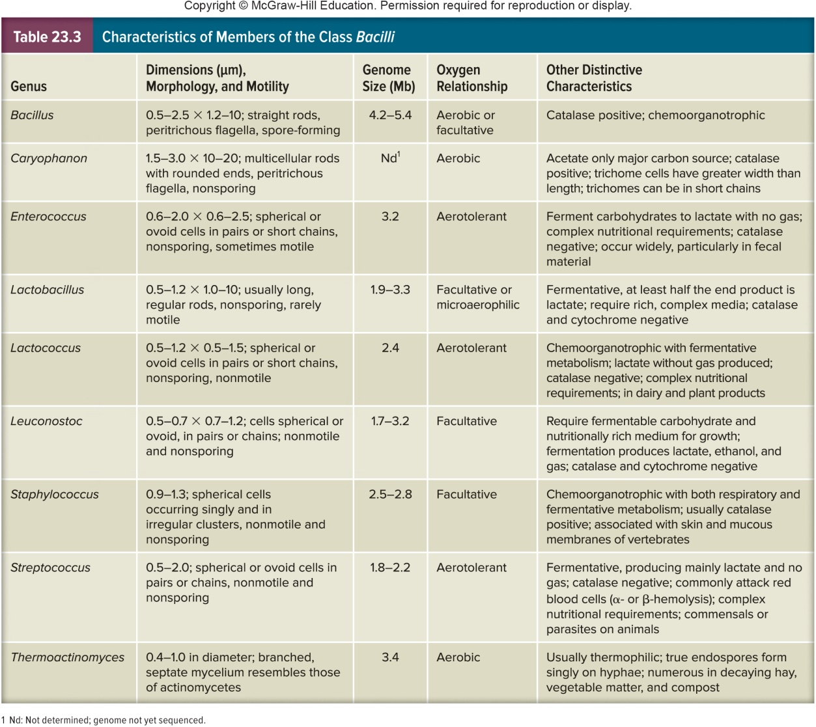
Class Bacilli
Large variety of Gram-positive organisms
Contains two orders, Bacillales and Lactobacillales
includes cocci, rods, and nonspore forming rods

Slide 20
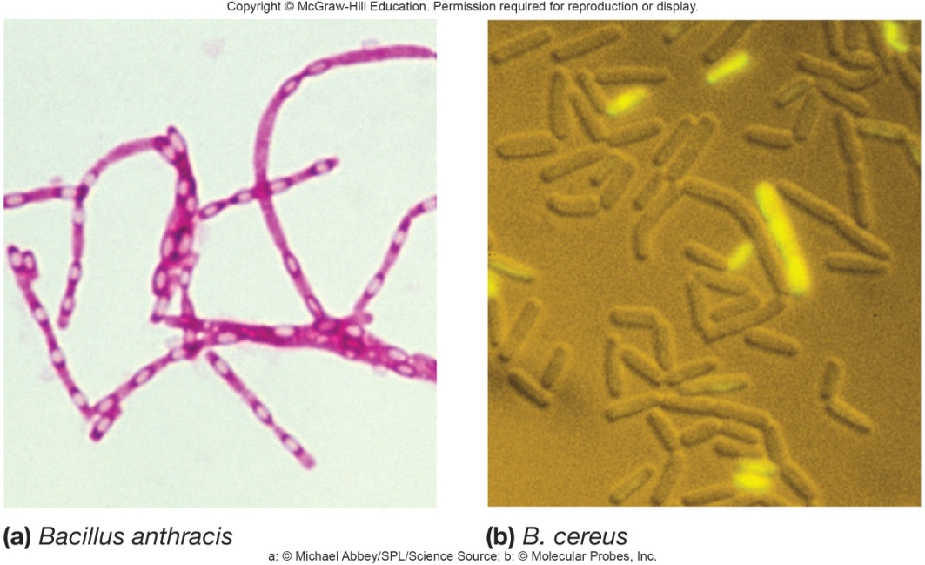
Genus Bacillus
Largest in order Bacillales
Motile, peritrichous flagella, usually aerobic, catalase positive
Various species produce antibiotics
Bacillus subtilis is type species
Gram-positive, facultative anaerobe
soil-dwelling, spore forming
may develop biofilms

Slide 21
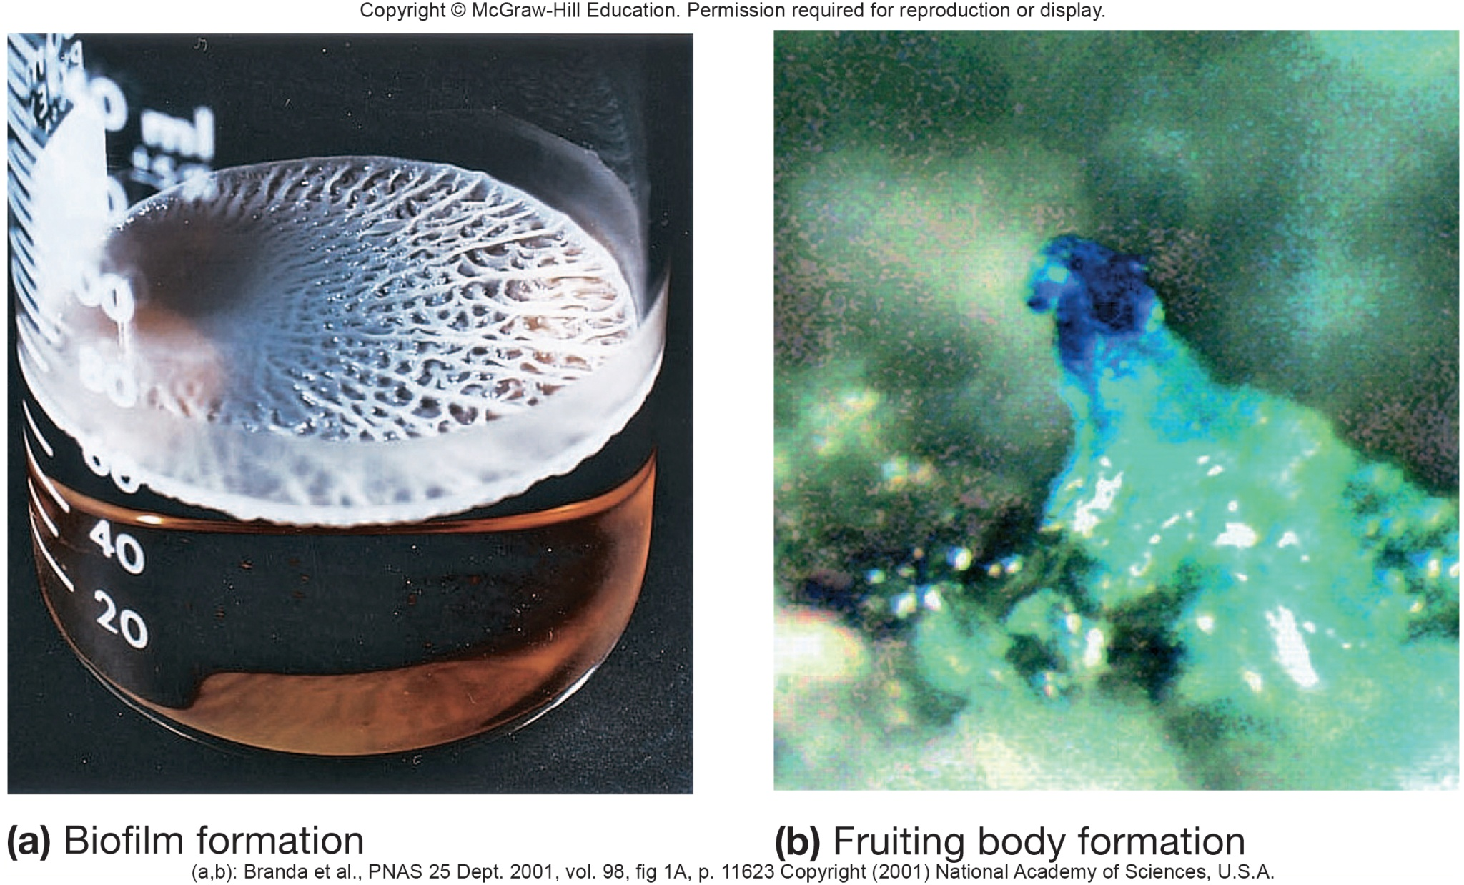
Biofilm Formation by Bacillus subtilis

Slide 22
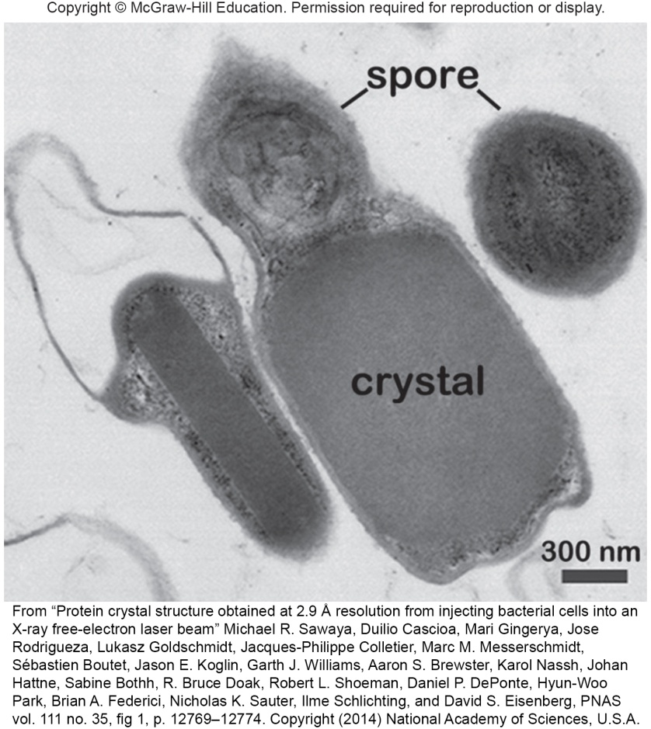
Bacillus species
Bacillus subtilis
Used as model organism for gene regulation, cell division, quorum sensing, cellular differentiation
4.2 Mb genome was one of first to be sequenced
families of genes expanded by gene duplication
18 genes for sigma factors
B. cereus – food poisoning
B. anthracis – anthrax
B. thuringiensis and B. sphaericus – used as insecticide
parasporal body – solid protein crystal that contains toxin

Slide 23
Genus Thermoactinomyces
Historically classified as actinomycete
Phylogenetic analysis
places it with low G + C microbes in order Bacillales, family Thermoactinomycetaceae
True endospore former
Found in high temperature environments such as composts
May be cause of farmer’s lung

Slide 24
Genus Sporosarcina
Only known endospore - former that has coccoid and not rod shape
Tolerates pH up to 10
degrades urea to ammonia and carbon dioxide
Isolated from agricultural soils where animals urinate

Slide 25
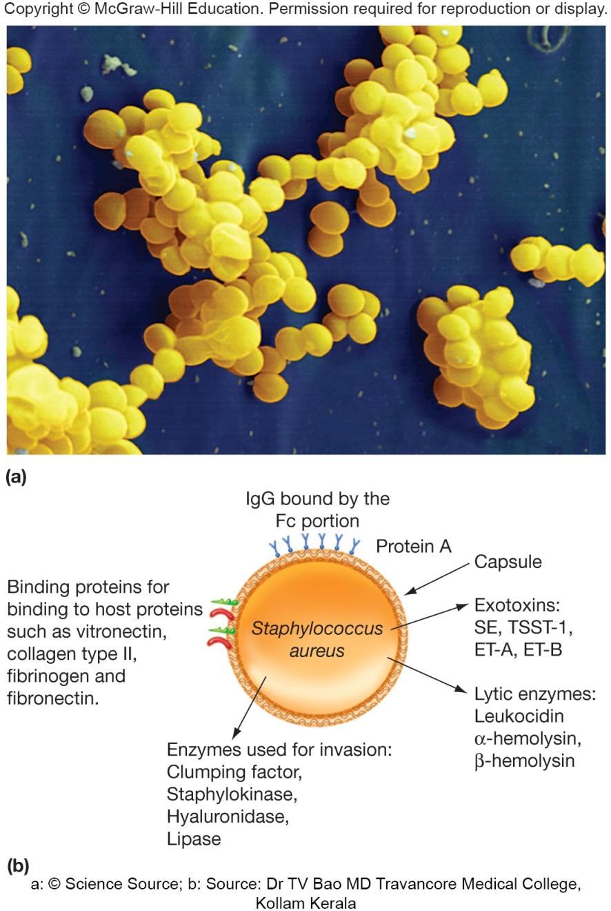
Family Staphylococcaceae
5 genera, includes Staphylococcus
Facultatively anaerobic, nonmotile, Gram-positive cocci
Usually form irregular clusters
Normally associated with warm-blooded animals in skin, skin glands, and mucous membranes

Slide 26
Staphylococcus epidermidis
Common skin resident
Sometimes responsible for endocarditis and for infections of patients with lowered resistance
e.g. wound infections, surgical infections, and urinary tract infections

Slide 27
Staphlococcus aureus
Most important human staphloccoccal pathogen
e.g. abscesses, boils, wound infections, pneumonia, toxic shock syndrome
major cause of common food poisoning
Virulence factors
coagulase which causes blood plasma to clot
the toxin β-hemolysin lyses cells

Slide 28
S. aureus Antibiotic Resistance
Methicillin-resistant S. aureus (MRSA) and vancomycin resistant S. aureus (VRSA)
among most threatening antibiotic resistant
VRSA may have no treatment
obtained from genetic elements received from other organisms
virulence factors also acquired from mobile genetic elements

Slide 29
Genus Listeria
Short rods, facultative anaerobic, catalase positive
Motile by peritrichous flagella
Wide distribution in nature
common in decaying matter
L. monocytogenes pathogen of humans and animals
listeriosis - food-borne infection

Slide 30
Order Lactobacillales
Also called lactic acid bacteria (LAB)
Morphologically diverse
nonsporing
usually nonmotile
Ferment sugars for energy
lack cytochromes
Fastidious
Contains several important genera

Slide 31
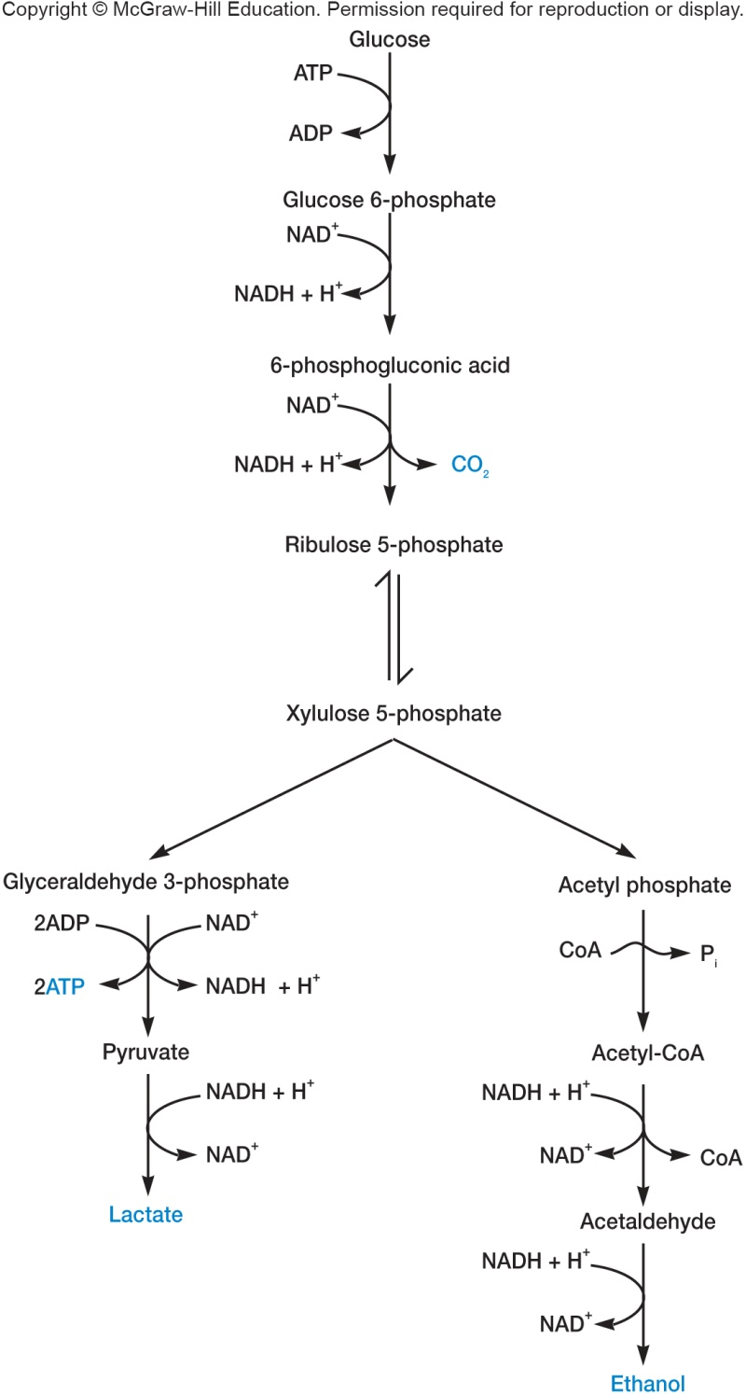
Lactic Acid Bacteria
Largest genus - Lactobacillus
sometimes coccobacilli
grow optimally in slightly acidic conditions (pH 4.5 to 6.4)
two fermentation pathways
homolactic fermentation (via glycolytic pathway)
heterolactic fermentation (via pentose phosphate pathway)
Widely distributed in nature
on plant surfaces
in dairy products, meat, water, sewage, beer, fruits, and other materials
normal flora of mouth, intestinal tract, and vagina
usually not pathogenic

Slide 32
Importance of Lactobacilli
Fermented products
vegetable products (sauerkraut, pickles, and silage)
beverages (beer, wine, juices, milk)
Sour dough bread
Swiss cheese and other hard cheeses, yogurt
Sausages
L. acidophilus – sold as probiotic agent
Food spoilage – beer, wine, milk, meat

Slide 33
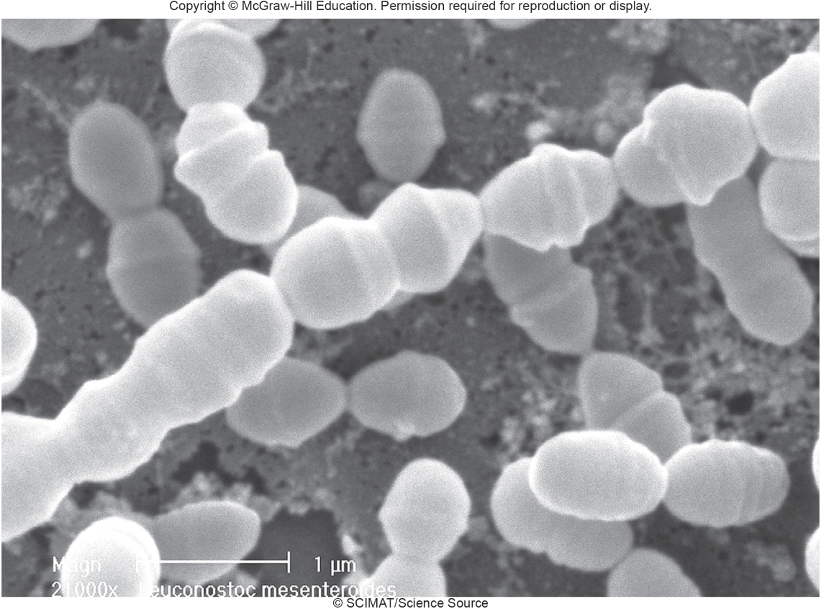
Family Leuconostocaceae Genus Leuconostoc
Facultative, Gram-positive cocci
Heterolactic fermentation via
phosphoketolase pathway
Isolated from plants, silage, and milk

Slide 34
Importance of Leuconostoc
Wine production
Production of sauerkraut and pickles
Production of buttermilk, butter, and cheese
Synthesis of dextrans (L. mesenteroides)
Involved in food spoilage
tolerate high sugar concentrations
grow in heavy syrup

Slide 35
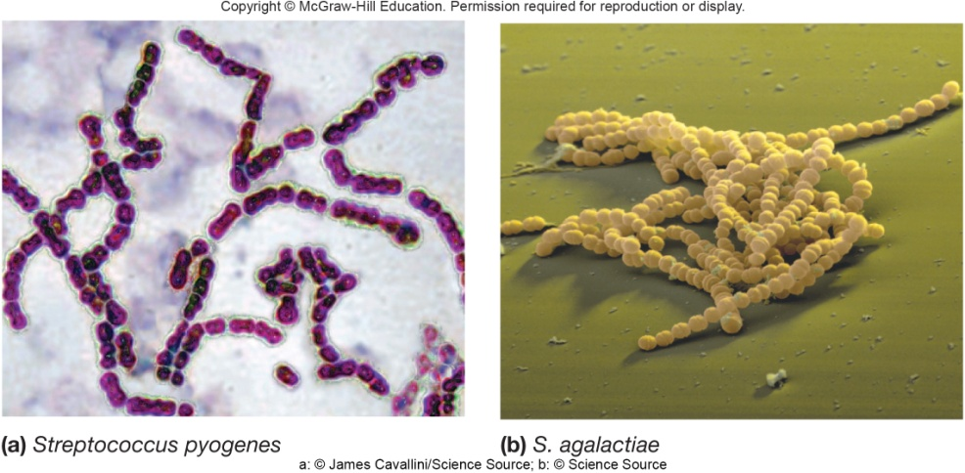
Families Streptococcaceae and Enterococcaceae
Chemoheterotrophic, mesophilic, nonsporing cocci, usually nonmotile
Fermentative only
Aerotolerant and anaerobic
Groups
enterococci
lactococci
streptococci

Slide 36
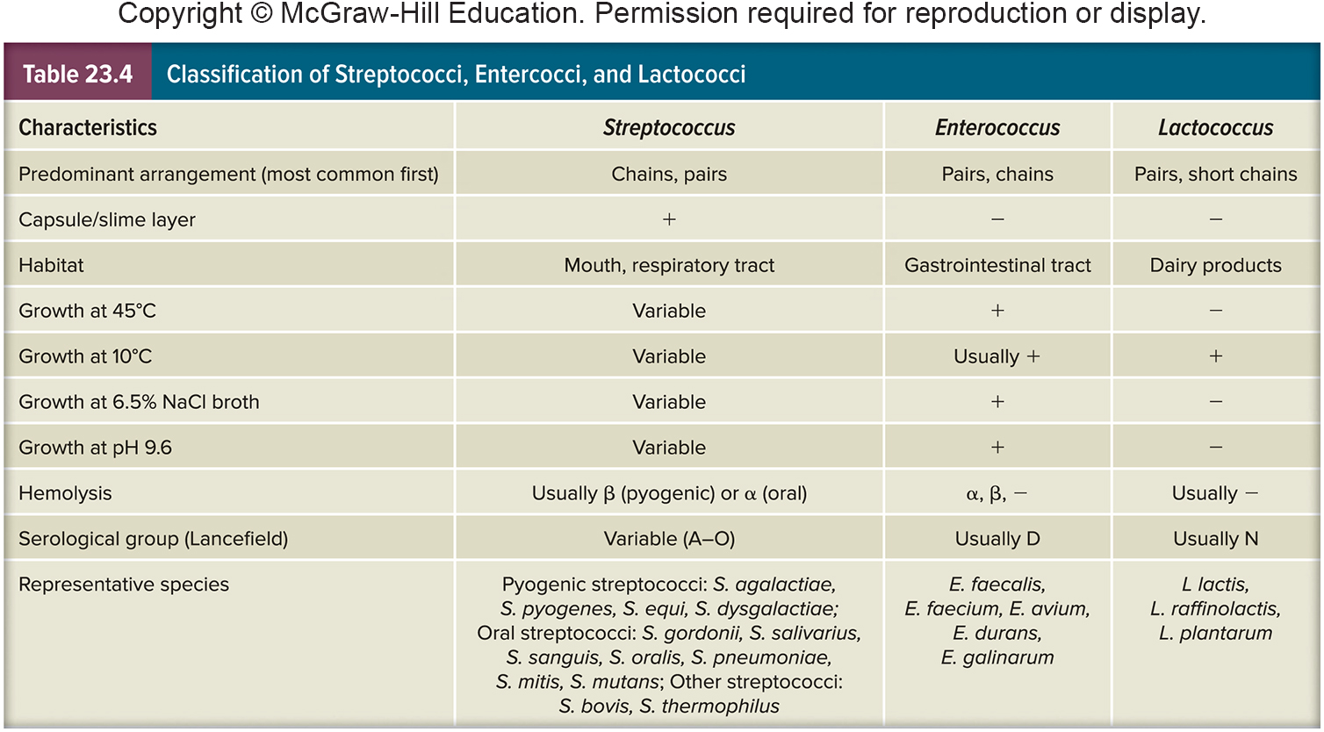
Classification of Streptococci, Enterococci, and Lactococci

Slide 37
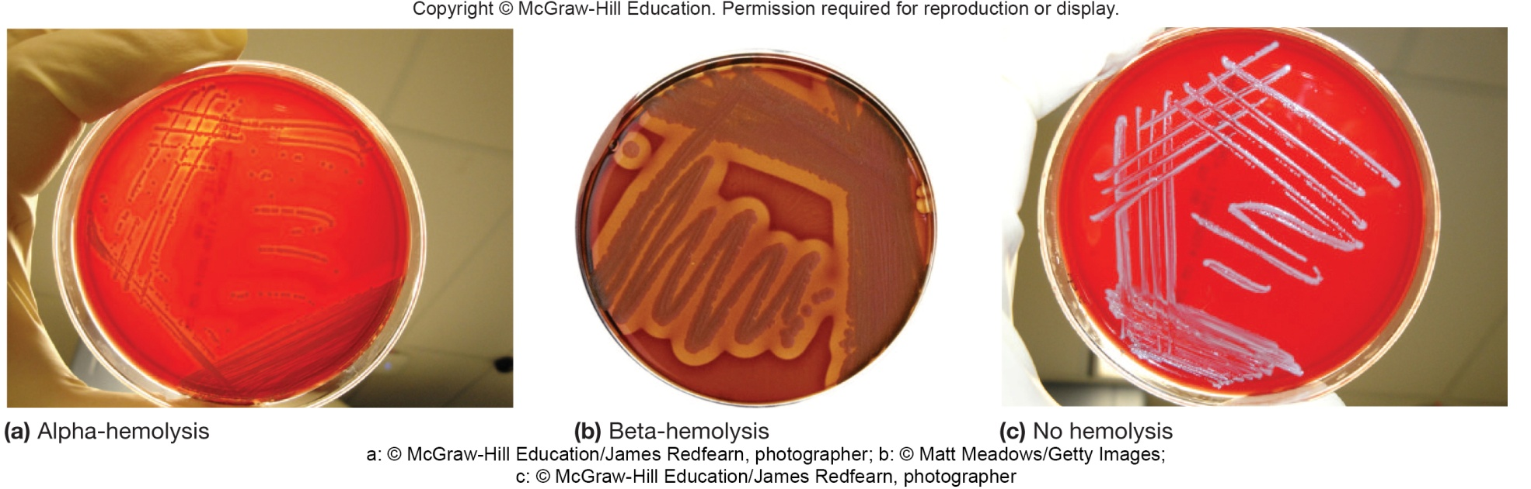
Genus Streptococcus
Hemolysis patterns used in Lancefield grouping
alpha (α) – hemolysis
incomplete lysis of red blood cells
seen as greenish zone around colony on blood agar
beta (β) − hemolysis
complete lysis of red blood cells
seen as clear zone around colony on blood agar

Slide 38
Three Groups of Streptococci
Pyogenic (pus producing) streptococci
e.g. S. pyogenes – streptococcal sore throat, acute glomerulonephritis, and rheumatic fever
Oral streptococci
e.g. S. mutans – dental caries
Other streptococci
e.g. S. pneumoniae – lobar pneumonia and otitis media

Slide 39
Important Enterococci and Lactococci
Enterococcus faecalis
normal biotic in gastrointestinal tract
opportunistic pathogen (urinary tract infections and endocarditis)
Lactococcus lactis – production of buttermilk and cheese

Slide 40
Take Home Message
This taxonomy chapter covers several groups of microbes, their structures, their metabolism, and their characteristics
Taxonomy is a tricky field to study
The best idea is to try to distill out how each microbe is different from the others, and how it could contribute to/draw from its local environment
Once you have a feel for the local effects, try to think about the pathogenic nature of some of these microbes as well as the ways we can exploit them for our own desired purposes

